Slide 1


Pets
Merit Badge
Troop 344 and 9344
Pemberville, OH

Slide 2
Pets Merit Badge Requirements
Present evidence that you have cared for a pet for four months. Get approval before you start.
Write in 200 words or more about the care, feeding, and housing of your pet. Tell some interesting facts about it. Tell why you have this kind of pet. Give local laws, if any, relating to the pet you keep.
Show that you have read a book or pamphlet, approved by your counselor, about your kind of pet. Discuss with your counselor what you have learned from what you read.
Do any ONE of the following:
  Show your pet in some pet show.
  Start a friend raising a pet like yours. Help your friend get a good start.
  Train a pet in three or more tricks or special abilities.

Slide 3

Before You Begin
If you are not a pet owner and plan to buy or adopt an animal to earn this merit badge, first give serious thought to pet ownership. You must realize what every responsible pet owner already knows: It takes time, effort, and money to care for a pet properly. You must provide food and shelter for your pet. You must ensure quality health care for your pet, which could include vaccinations and preventive and emergency care as needed. You must take the time to properly train your pet so that it does not become a nuisance. You must dedicate yourself to the well-bing of a living animal, which means sometimes giving up other activities to tend to your pet’s needs.

Slide 4

Before You Begin
Consider what type of pet to choose. Understand that different pets require different living arrangements. For example, a large-breed dog will need a large yard and a lot of space for exercise. Municipal laws may restrict the types of pets you keep, and some pets may not be allowed in certain types of homes and appartments. Remember that a Scout is courteous, and keep in mind that good pet owners are always courteous to their neighbors.

Slide 5

Before You Begin
When you get a pet, it is a commitment for the lifetime of the pet, and you must be prepared to honor that commitment. Your pet might live for quite a long time. Dogs and cats regularly live for more than 10 years, and some parrots can live for decades. Do not count on your parents or someone else to finish what you have started just because it is no longer convenient to do so.
Despite what appears to be a long list of things to consider when adding a pet to your life, all of these things can be done.

Slide 6
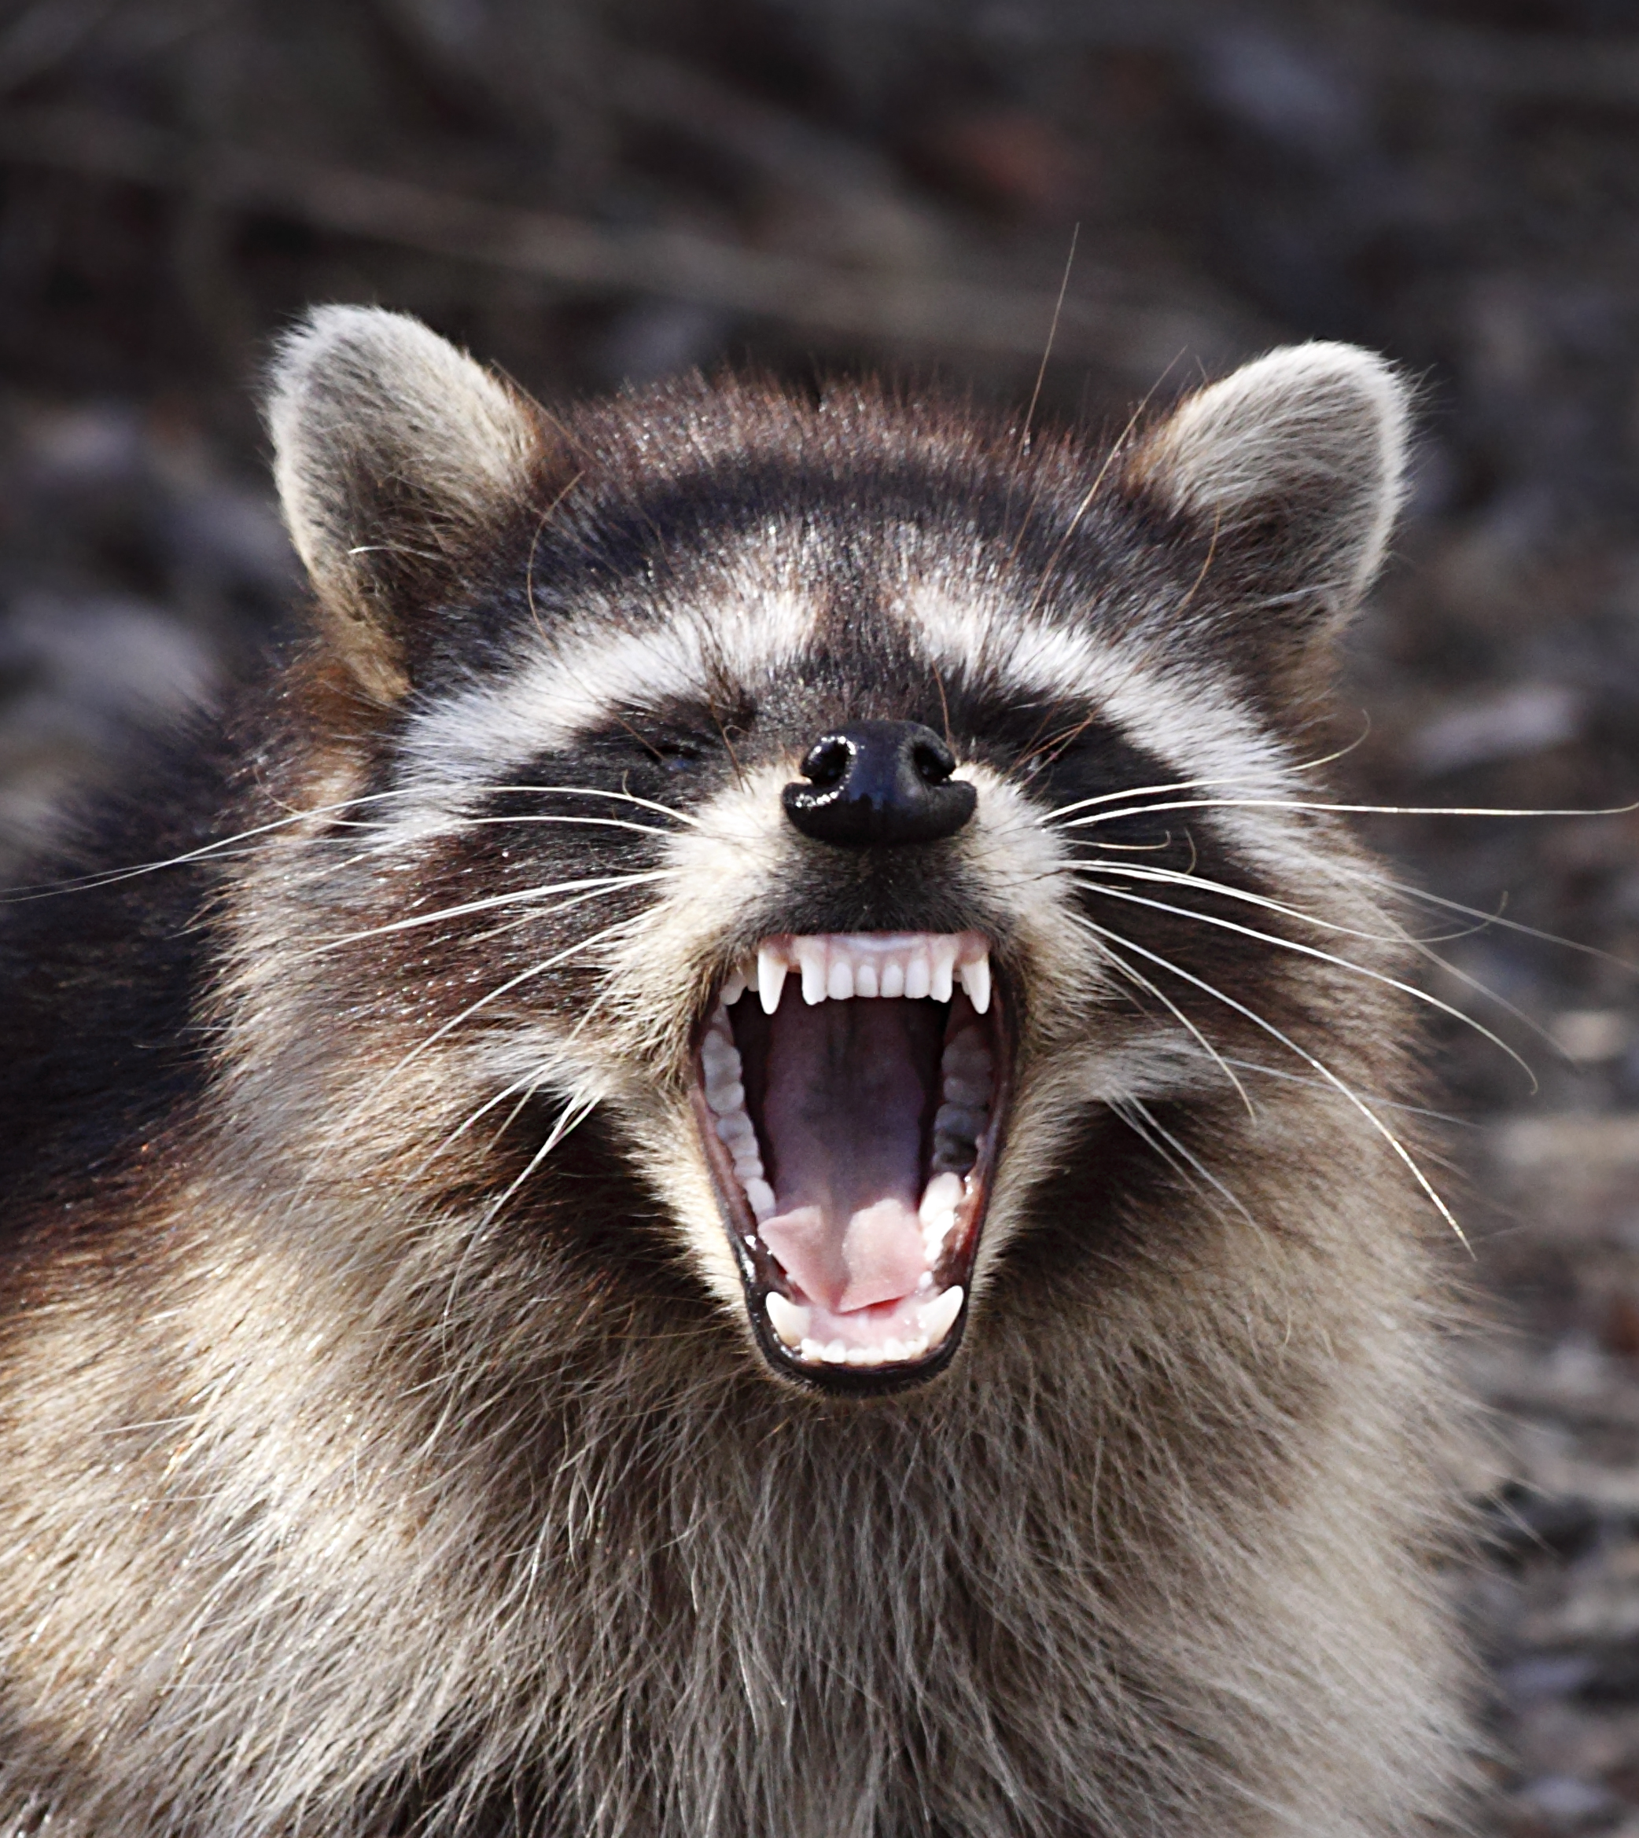
Before You Begin
Do not keep wild animals such as squirrels, raccoons, or opossums as pets. Wild animals should be left in their natural habitat and enjoyed only when encountered there. Also, wild animals could carry disease and pests such as ticks and fleas. Many states and localities have laws concerning or prohibiting the keeping of wild animals as pets.

Slide 7

Before You Begin
There are so many different pets you could choose to keep that it would be difficult to discuss all of the options, care instructions, and laws or ordinances that may apply to your pet within this PowerPoint. Please read the Pets Merit Badge Pamphlet for a more thorough introduction before you begin.

